Slide 1
DriverPass System Analysis
Jas King
Notes:
[No speaker notes required for this slide.]

Slide 2
System Requirements
Functional Requirements:
Access to Practice Tests: Users can take practice tests that mimic real driving exams. The system tracks their progress to help them assess their performance and find areas to improve.
Scheduling Driving Lessons: Users can book lessons using a real-time calendar that shows available slots and prevents double bookings for better scheduling.
Non-Functional Requirements:
User Authentication: Users must create a unique, case-sensitive username and password. The system verifies these during login to ensure security.
Cloud-Based Architecture: The application will be cloud-based for scalability and access from multiple devices, allowing users to connect from anywhere with internet access.
Notes:
When creating a cloud-based web application for driving instruction, it's crucial to identify both functional and non-functional requirements that will shape the system's design and user experience. This post will highlight these requirements, emphasizing key features that will boost user engagement and ensure secure access. The specified functional and non-functional requirements are vital for the successful launch of the driving instruction application. By prioritizing user access to practice tests and lesson scheduling, along with strong security measures and a cloud-based setup, we can develop a comprehensive and user-friendly platform that caters to the needs of future drivers.

Slide 3
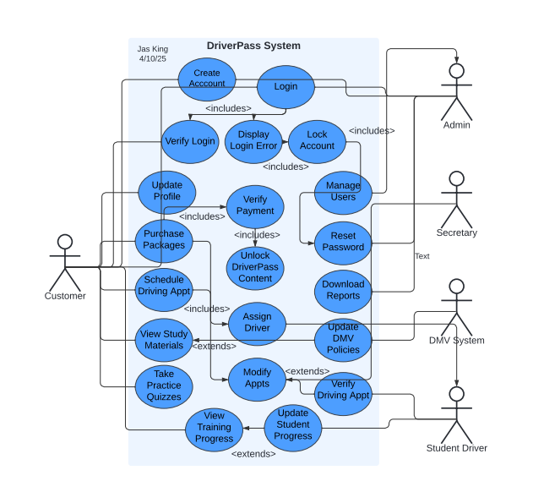
Use Case Diagram
Notes:
User Roles and Interactions:
Admin: Manages system operations, oversees user activities, and ensures compliance with DMV regulations. Updates the company on DMV law changes.
Customer: Schedules and modifies appointments, views their calendar, tracks training progress, resets passwords, and explores training options.
DMV System: Ensures regulatory compliance and facilitates communication within the DriverPass system. Handles notifications about DMV law changes for user awareness.
Secretary: Accesses user profiles and monitors student progress, enabling instructors to give personalized feedback and enhance training effectiveness.
System Functionalities:
The DriverPass system aims to provide a smooth experience for users by offering a range of functionalities. Important actions available in the system include:
Appointment Management: Users can schedule and change appointments, with the system monitoring all bookings to optimize scheduling and resource use.
Progress Tracking: Customers can check their training progress, and instructors can view this data to offer assistance and support.
User Authentication: All users, including customers and IT staff, can log in and reset their passwords, ensuring secure access to the system.
To sum up, the use case diagram for the DriverPass system illustrates how different user roles interact with the system's features. By outlining these interactions clearly, we can make sure the system is easy to use, efficient, and meets regulatory requirements. This organized method improves user experience and supports better system management and monitoring. I welcome your feedback and ideas on this subject.

Slide 4
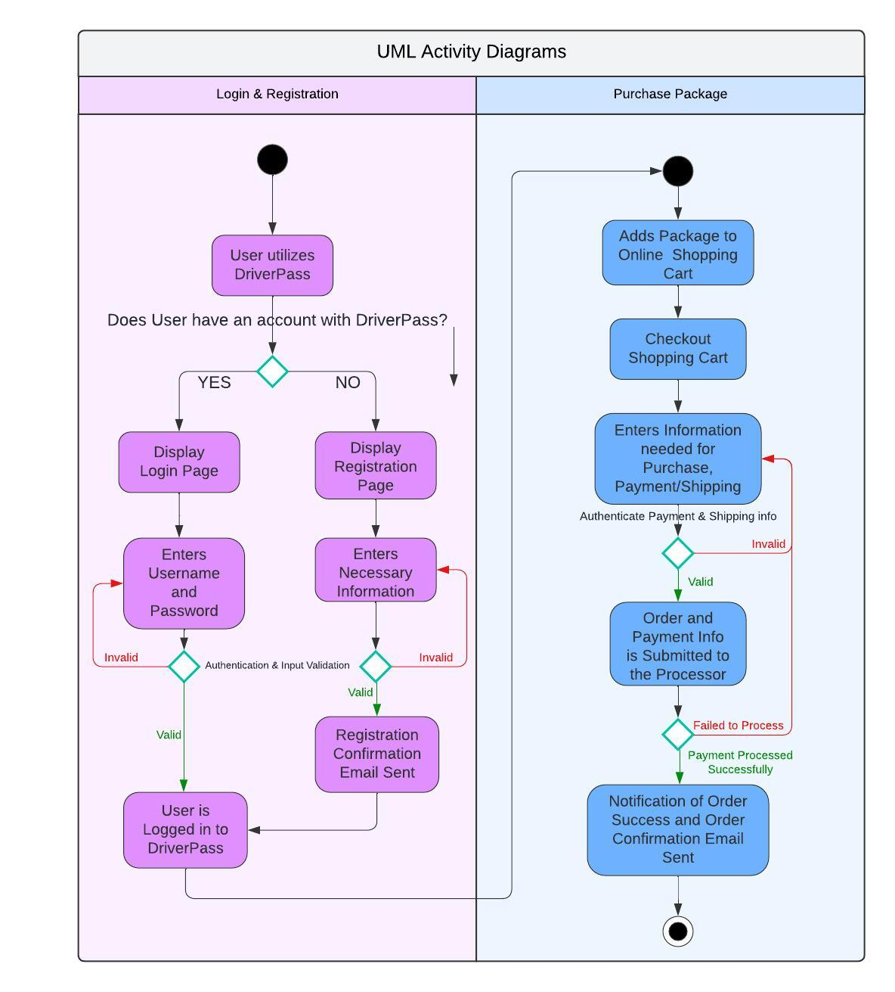
Activity Diagram
Notes:
In creating this activity diagram, I considered the needs of both DriverPass users and the IT department. The diagram details the steps for logging in and resetting passwords while also including a support system through the IT department, ensuring users can get help when necessary. This combined approach improves user experience and security, reflecting DriverPass's dedication to providing dependable and user-friendly services.
→ The process starts when the user enters their unique username and password, ensuring only authorized access to accounts.
If the information is correct, the user logs in and reaches the home page to explore DriverPass features.
If the username is wrong, access is denied, and the user must re-enter their login details to maintain account security.
If a user forgets their password but remembers their username, they will need to provide the associated email address.
If the email is incorrect, they will be prompted to try again.
Once the correct email is entered, a password reset email will be sent.
If the user does not receive the email, they should contact the IT officer for help. This is important for users facing issues with the password reset. If the email is received, the user can go to a secure page to reset their password.
→ After resetting their password, the user will get a confirmation that the process is complete.

Slide 5
Security
Admin Users will be able to remove or modify user accounts in response to any identified security threats.
01
User accounts will be temporarily locked after a specified number of unsuccessful login attempts.
02
The system will operate on a cloud-based platform.
03
Usernames and passwords will be securely stored in an encrypted database, while ensuring uniqueness with case sensitivity.
04
Notes:
In designing this system, we must place a high priority on security, especially for those hosted on cloud services. As we develop our architecture, we understand that strong security measures must be woven into every aspect, going beyond just the usual username and password setup. A key part of our security plan is the safe storage of usernames and passwords. To reduce the risk of unauthorized access, we will use an encrypted database for this sensitive data. Each username and password will be uniquely created and will include case sensitivity, increasing complexity and making it much harder for potential attackers to access user accounts. We also recognize the importance of administrative controls in keeping the system secure and well-managed. If a security issue arises, our administrators will have the ability to quickly remove or change user accounts. This proactive strategy is vital for addressing vulnerabilities and strengthening our system's overall security. To enhance our security measures, we will enforce a policy that locks users out of their accounts after a set number of failed login attempts. This not only helps prevent unauthorized access but also protects user data and the security of the connection between the system and its users. By implementing these safeguards, we aim to discourage any malicious attempts to breach our system. In recognizing that users might sometimes forget their passwords, we will offer a safe way to reset them. Users can reset their passwords through a secure method, allowing them to regain access to their accounts without risking security.

Slide 6

System Limitations
Time frame of only three months
Unknown project scope
Use of third-party for financial transactions
Web-based system limitations
Potential interface issues with DMV website
Inflexible system adaptability
Notes:
As we examine the DriverPass system's design, we must acknowledge its limitations. Recognizing these constraints will help us set realistic goals and guide future improvements.
The project has a strict three-month deadline, which may limit thorough development, testing, and refinement, potentially impacting quality and functionality. Additionally, the unclear project scope complicates resource allocation, feature prioritization, and addressing all necessary elements within the tight timeframe. The system will not handle financial transactions internally; instead, a third-party service will manage them, introducing risks related to security, reliability, and integration that could affect user experience. The current web-based design may exclude users who prefer mobile access, limiting engagement and accessibility. There is also a risk that DriverPass may not integrate smoothly with the DMV website, possibly requiring additional databases and complicating the process. Lastly, additional packages cannot be modified without developer involvement, which may hinder adaptability to changing user needs or market trends, affecting growth and relevance.
To sum up, the DriverPass system offers a hopeful solution, but it's important to acknowledge its limitations. Tackling these issues is essential for improving the system's performance and making sure it effectively serves its users.

